Slide 1
Cosmic Rays and the Discovery of the Positron
Lilla Barbara Klettner
08th of December, 2022,
Experimental Nuclear and Particle Physics Seminar

Slide 2
Lecture Plan:
Cosmic Rays
Spontaneous discharge of electroscopes
Experiments (terrestrial, extra-terrestrial)
What are Cosmic Rays
What is their source
Proving the theory
Discovery of the Positron
Cloud chambers
Anderson’s experimental setup
Discovery of the positron
Use today (in a few sentences)

Slide 3
Cosmic Rays

Slide 4
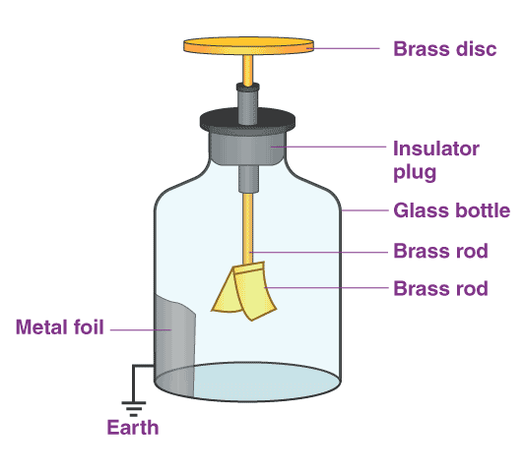
Spontaneous discharge of electroscopes
1785 Coulomb: spontaneous discharge by the action of the air
1835 Faraday: greater accuracy
Gold leaf
1875 Crookes: speed of discharge decreases with decreased air pressure
1. figure: Gold leaf electroscope

Slide 5
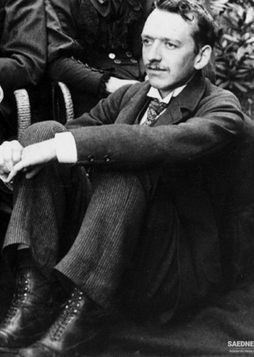
1903 Ernest Rutherford: non-radioactive metal shield reduces the ionization
Ionization comes from radioactivity
Where does this penetrating radiation originate from?
General idea: Earth’s crust
New idea:
1900’s Charles Thomson Rees Wilson: extra-terrestrial origin
2. figure: Charles Thomson Rees Wilson

Slide 6
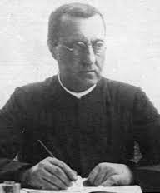
Investigating the origin
Theodor Wulf:
improved the electroscope design
(metalized silicon-glass wires)
1909: measured the ionization of the air in various locations (Germany, Holland, Belgium)
Radiation comes from the Earth’s crust
3. figure: Theodor Wulf
insulator
Metal rod
Metal wires
microscope
4. figure: Electroscope

Slide 7
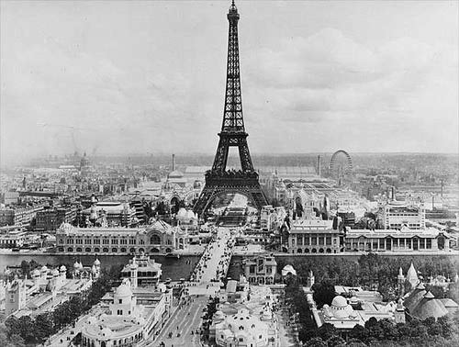
Theodor Wulf: Experiment on the Eiffel tower:
1909: Paris, Eiffel tower
300 m altitude
Expectation:
Distance equation: This equation uses the inverse square law to calculate the change in dose rate when a person moves farther or closer to a point source of x or γ radiation.
$D_{1}=D_{2}\frac{{X_{2}}^{2}}{{X_{1}}^{2}}$ ,
where D1 and D2 = dose rate (or intensity) at positions 1 and 2, respectively; X1 and X2 = the distance from the source at positions 1 and 2, respectively.
5. figure

Slide 8
Theodor Wulf: Experiment on the Eiffel tower:
What really happend:
Not even half of the ground value
Expectation:
$D_{1}=D_{2}\frac{{X_{2}}^{2}}{{X_{1}}^{2}}$ ,
$D_{2}= 2.3∙{10}^{−4}$ mSv/h = $2.3∙{10}^{−2}$ mrem/h - $X_{2}=3 feet$
$D_{1}=$? - ${ X}_{1}=$984.25 feet
$D_{1}=2.137∙{10}^{−7}$ mrem/h = $2.137∙{10}^{−9}$ mSv/h
(Original =
$2.3∙{10}^{−4}$ mSv/h)

Slide 9
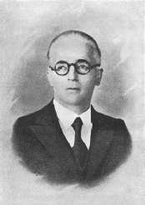
Domenico Pacini, Victor Franz Hess:
questioned, that radioactivity was mostly comming from the Earth’s crust
experimental program of systematic measurements of radiation on the ground and on the sea
Pacini’s experiment: (1911)
300 m from the beach of Livorno
two thirds of the ionization on the ground
Result:
6. figure: Domenico Pacini

Slide 10
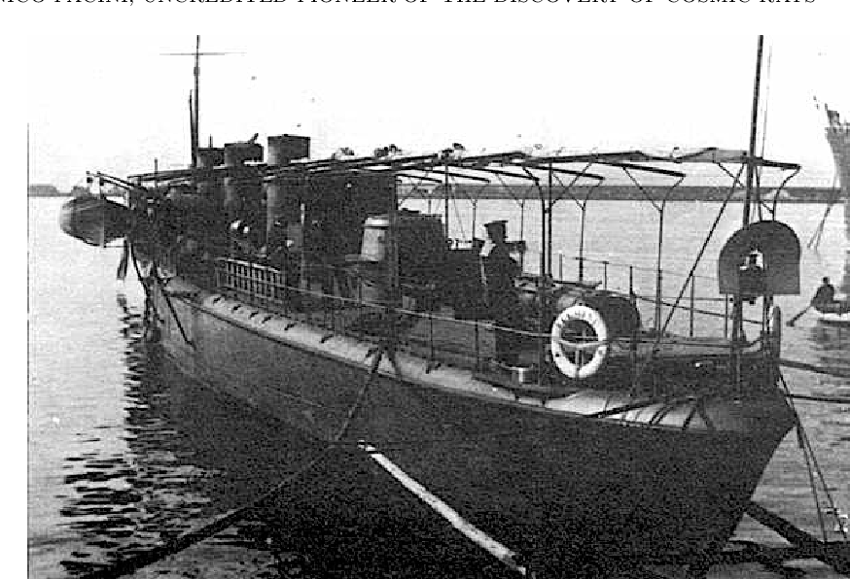
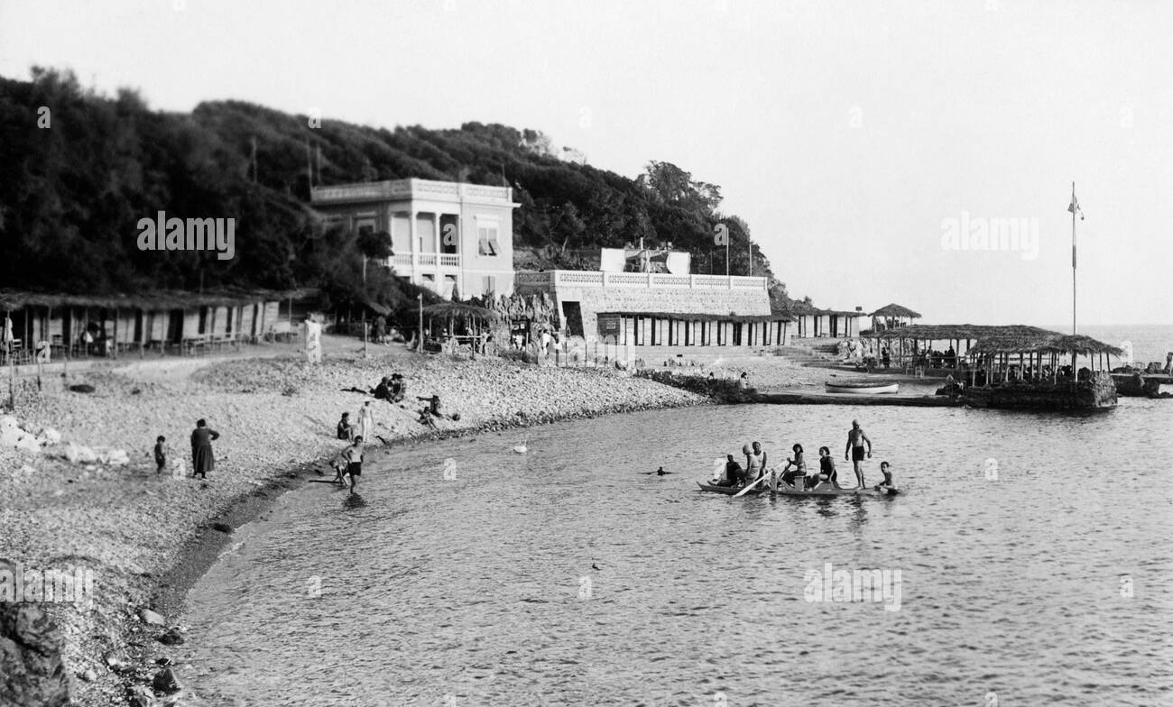
„appears from the results of the work described in this Note that a sizable cause of ionisation exists in the atmosphere, originating from penetrating radiation, independent of the direct action of radioactive substances in the soil.”
7. figure: The ship used in Pacini’s experiment
8. figure: Livorno beach

Slide 11
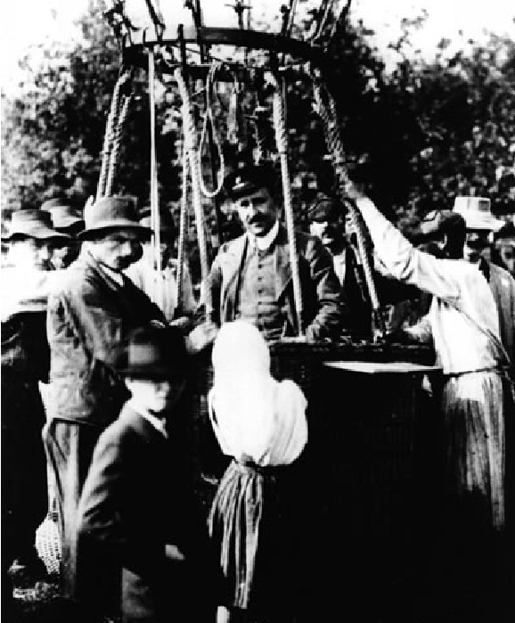
Hess’s experiment: (1912)
measured the ionization of the atmosphere during balloon flights
Results:
first the radiation diminished with height, then at around 1500 meters this reversed
9.figure: Hess’s balloon flight
„The discoveries revealed by the observations here given are best explained by assuming that radiation of great penetrating power enters the atmosphere from the outside and engenders ionization even in the counter lying deep in the atmosphere. The intensity of this radiation appears to vary hourly.”

Slide 12
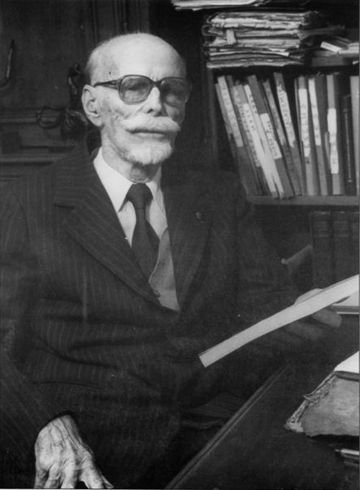
Pierre Auger:
1938, measurements in the Alps
Two Geiger counters placed far apart
Result: sometimes they detected Cosmic Rays at the same time
10. figure: Pierre Auger
Cosmic Ray showers
(Different size = different amount of energy)

Slide 13
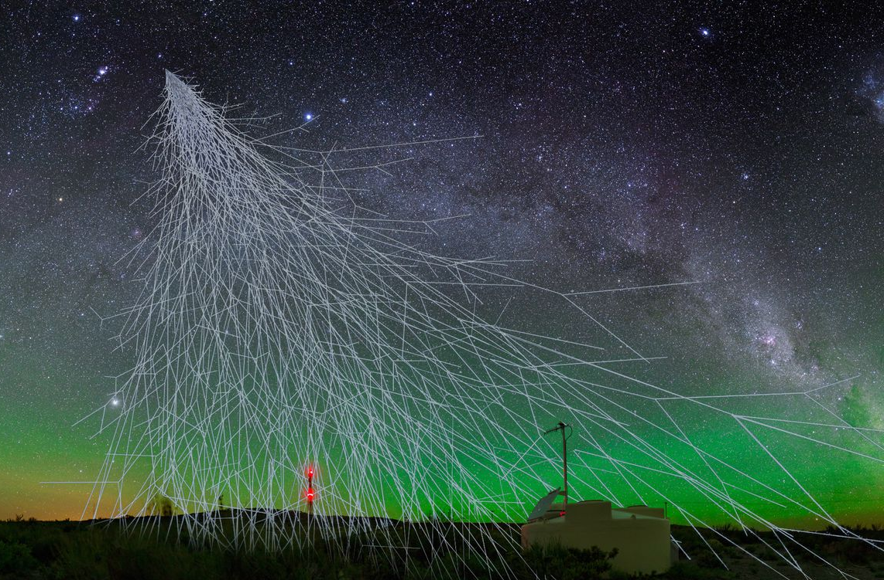
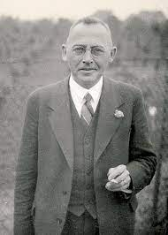
What particles are Cosmic Rays made of ?
Millikan: electromagnetic radiation (gamma-rays) produced as by-products of interstellar fusion
1929, Walter Bothe and Werner Kolhörster: CR particles can’t be photons
1945, further investigations:
99% : Protons, α-particles
1% : nuclei of heavy ions
11. figure: Csomic Ray shower
Walter Bothe and Werner Kolhörster

Slide 14
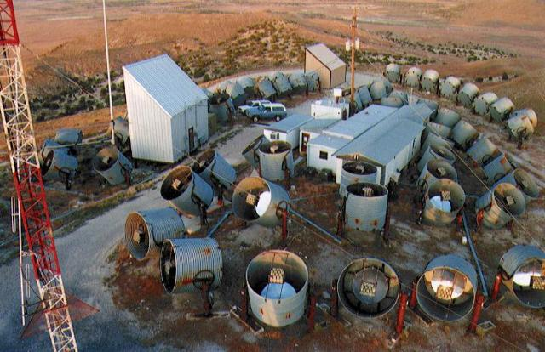
What is their source ?
1980’s, Utah, Fly’s Eye:
UV glow of CR showers
Goal: direction of Cosmic Rays
Result:
Everywhere: stars create complex network of magnetic fields
11. figure: Fly’s Eye experiment

Slide 15
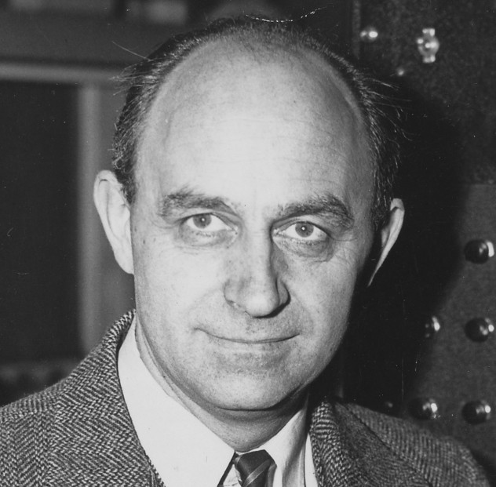
1949, Enrico Fermi:
Charged particles accelerated in changing B field
Extremely high energy sources may also throw of x-rays
X-rays are absorbed by the atmosphere
Measurements must take place above the atmosphere
12. figure: Enrico Fermi

Slide 16
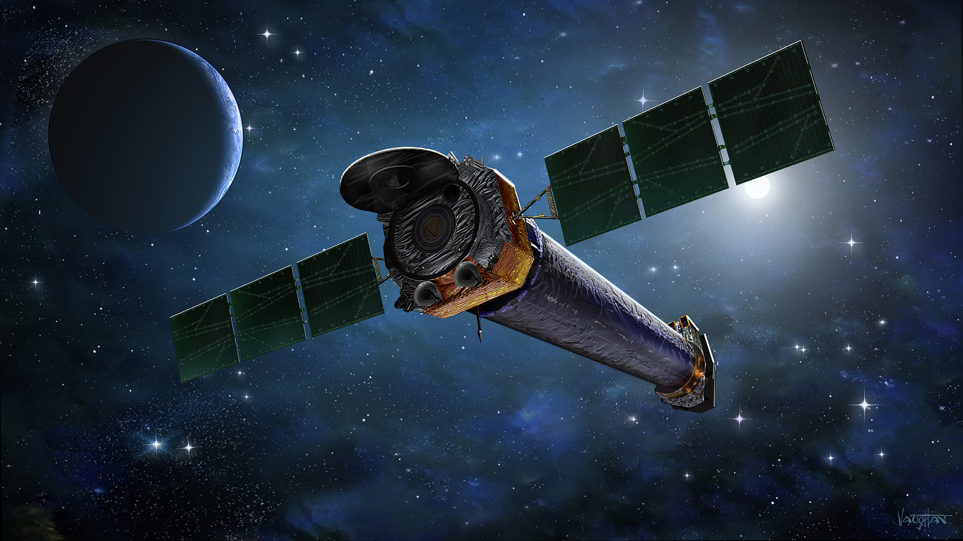
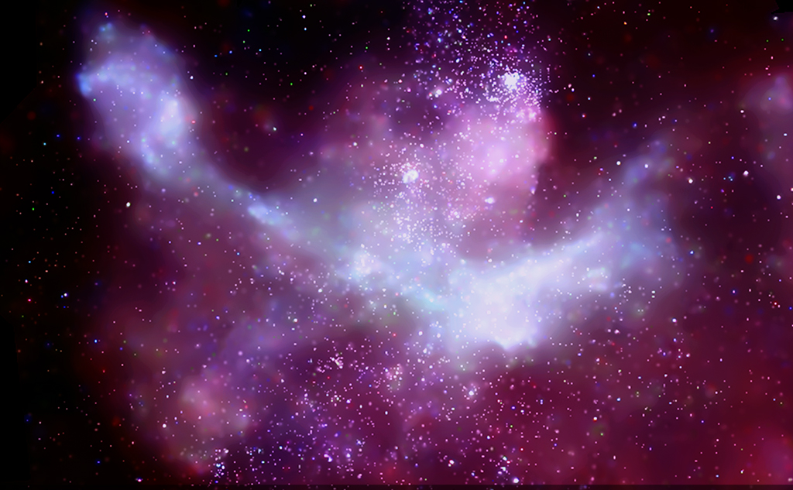
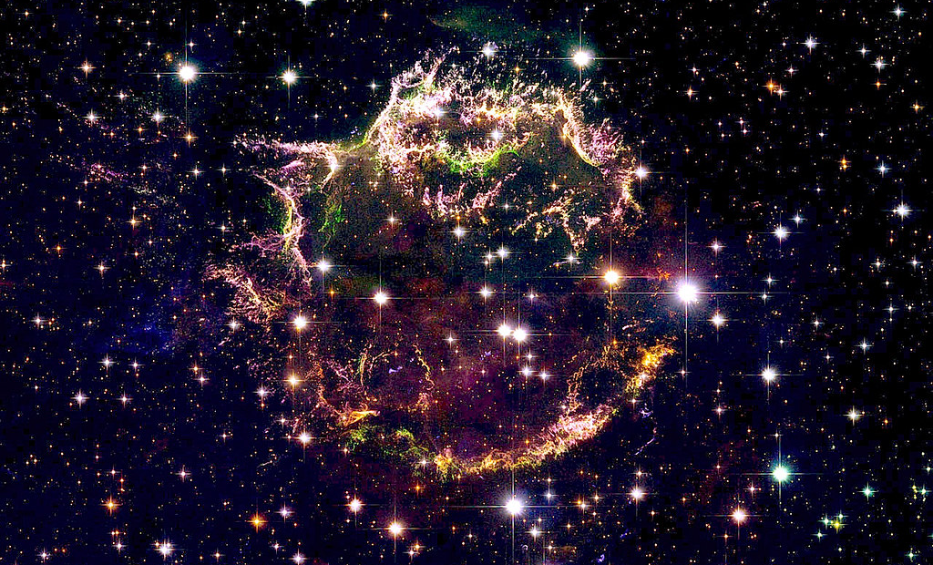
The Chandra X-Ray Observatory:
13.figure: Chandra X-Ray Observatory
14. figure: Birth of stars (Carina Nebula)
Fermi acceleration:
Supernova shockvawes can compress and strenghten B fields
particles moving back and forth enough energy to escape
15.figure: Cassiopeia A Supernova

Slide 17
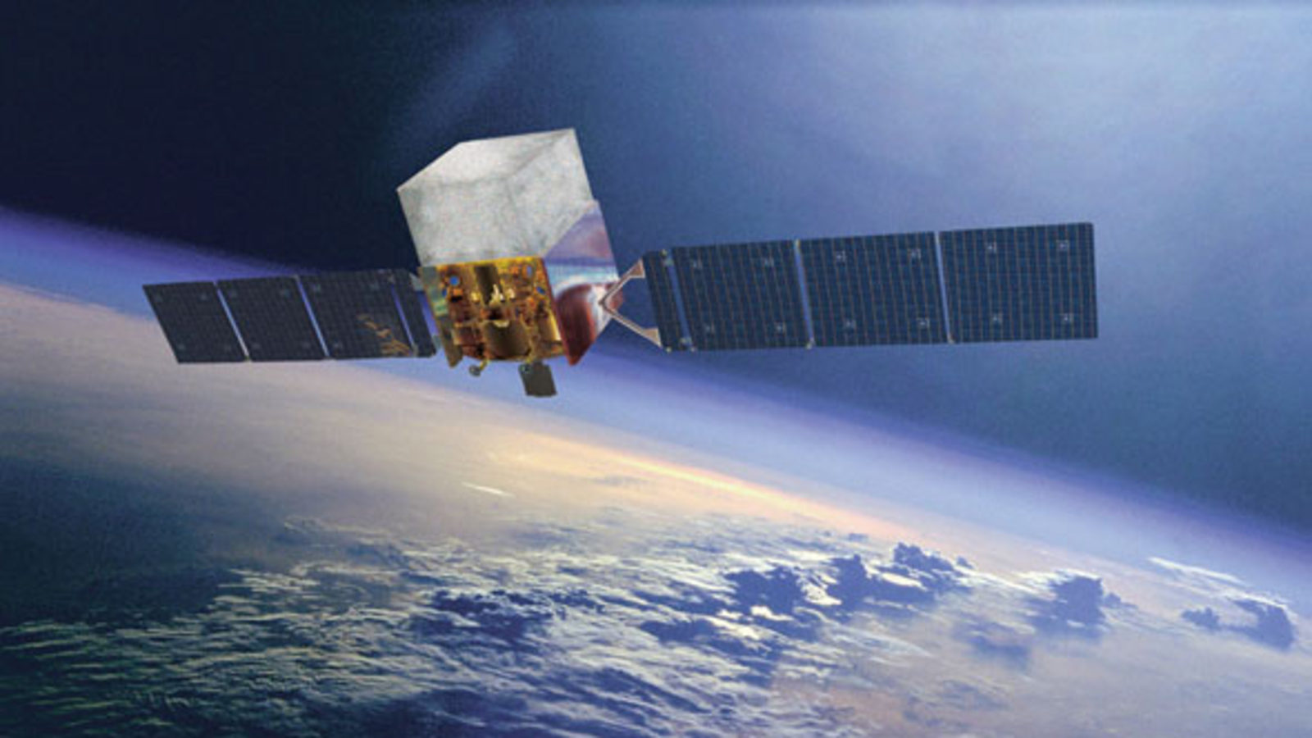
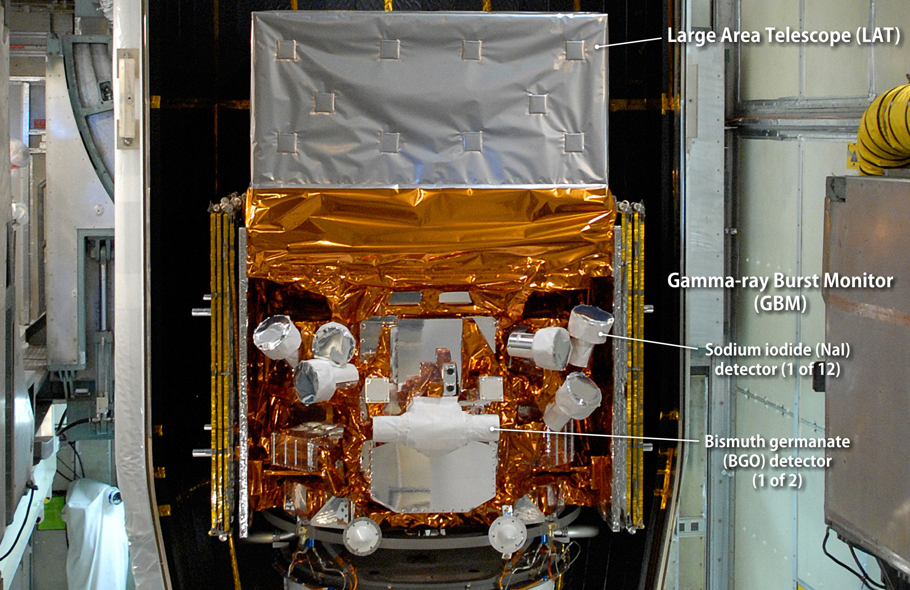
Proving the theory
Fermi Gamma-ray Space Telescope:
16. figure: Fermi Gamma-Ray Space Telescope
17. figure: FGRST Detectors
Distinguish between gamma-rays from different sources
supernova remnants w44, ic44
2013: 2 high energy protons colliding to produce gamma-rays

Slide 18
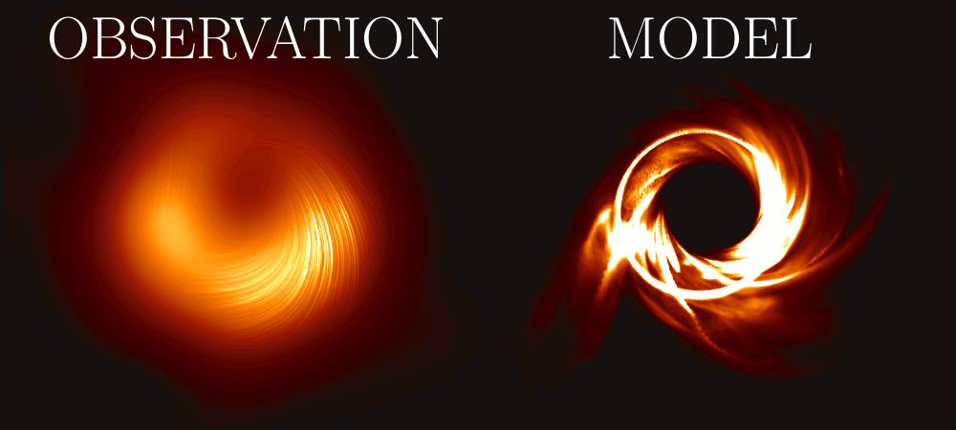
Summary
Extra-terrestrial ionisation
Protons, nuclei of heavy ions
Supernova shockwaves + Fremi acceleration
Fermi Gamma-ray Space Telescope
Other possible sources:
M87
giant galaxy
16 million lightyears away
Black Hole: 6 billion Suns
Gas rapid spin jet
18. figure: M87 Black Hole

Slide 19
Positron

Slide 20
Cloud Chambers
1911, Charles Thomson Rees Wilson:
19. figure: α- and β-ray of radium
20. figure: α-tracks of radium

Slide 21
Anderson’s experimental setup
1930’s, CALTECH, Carl D. Anderson & Robert Millikan
measuring the energy of cosmic ray particles
+ 6mm lead plate
Lorentz force law: F=q(E+v×B)
oppositely charged particles, different paths
21. figure: Wilson’s original design

Slide 22
Chamber:
d = 17 cm
between two coils
Coils:
d = 1 m
copper tubes
Cooling water
Electric current
m > 2 tons
425 kW
1.7 T
1600 pictures
22. figure: Anderson’s experiment

Slide 23
Discovery of the Positron
evening of 2nd August , 1932
Anderson studying photos:
track with curvature opposite to electrons
mass much less than a protons (~electrons)
originated from the bottom of the chamber
Equations used:
$p=qBR$
$E^{2}={(mc^{2})}^{2} + {(pc)}^{2}$
23. figure: Positron track

Slide 24
February, 1933: The Positive Electron (Journal of Science)
June, 1933: Cosmic-Ray Positive and Negative Electrons
Interpretations of the track:
The particle is a proton.
The track is in fact two tracks of electrons moving downwards.
The track is from an electron that somehow gained energy when penetrating the led plate.
The particle is a positively charged electron.
1936, shared Nobel Prize with Viktor Hess

Slide 25
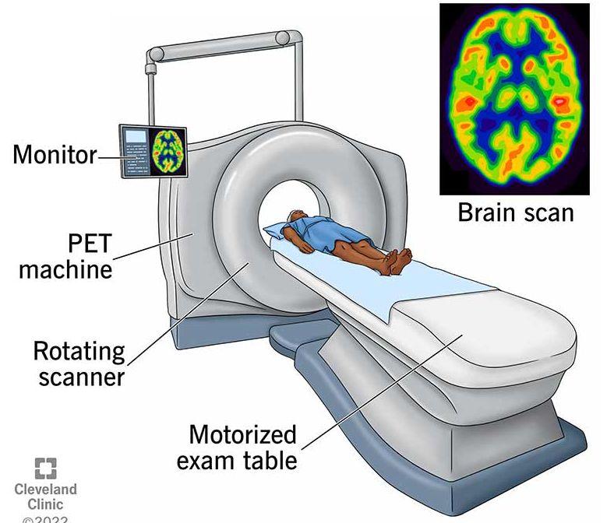
Use today
Cosmic Rays:
Particle physics: finding new particles
Positron:
PET: positron emission tomography
Finding tumors
Radioactive elements with short half-life (F isotope)
Electron-Positron annihilation
24. figure: PET scan

Slide 26
Thank you for your attention

Slide 27
References/Papers:
1208.6527.pdf (arxiv.org)
FULLTEXT01.pdf (diva-portal.org)
The Positive Electron (aps.org)
Cosmic-Ray Positive and Negative Electrons (caltech.edu)

